Slide 1
Can we rely on p-values?
A Simulation-Based Reassessment of Goodness-of-Fit Tests in Actuarial Science
MICHAEL OKANTA MSc. Statistics

Slide 2
Background & Motivation
In actuarial science, accurate statistical models are essential for estimating insurance claims, setting premiums, and managing risk.
Goodness-of-fit (GoF) tests help assess how well a chosen model reflects the observed data, including central tendencies and tail risks.
Many practitioners rely heavily on p-values as a binary decision tool (e.g., reject or not reject), often without understanding the assumptions behind them.
Recent statistical debates have questioned the reliability of p-values, especially in small samples, complex models, or heavy-tailed distributions common in actuarial datasets.
We aim to critically assess whether p-values from standard GoF tests can be trusted for actuarial decision-making, especially under slight model misspecification.

Slide 3
Objectives & Research Question
To reassess the reliability and interpretability of p-value reports from four common GoF tests within actuarial model validation frameworks.
Evaluate the behavior of four GoF tests under well-specified models.
Examine the empirical distribution of p-values under the null.
Assess the statistical power of these tests under local misspecification.
❓ Core Research Question
Can p-value reports alone provide sufficient evidence for model adequacy in actuarial decision-making, or do they risk misleading inference when used in isolation?

Slide 4
Overview of GoF Tests
Kolmogorov–Smirnov (KS) Test
Measures the maximum absolute difference between the empirical and theoretical cumulative distribution functions (CDFs).
Anderson–Darling (AD) Test
Enhances the KS test by giving more weight to tail discrepancies.
Chi-Square Test
Compares observed vs expected frequencies across binned intervals.
Effective for categorical or discretized data.
Cramér–von Mises (CvM) Test
Focuses on the squared difference across the entire distribution.
Balances sensitivity across center and tails, offering a more global fit assessment.

Slide 5
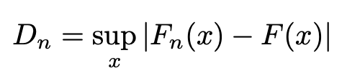
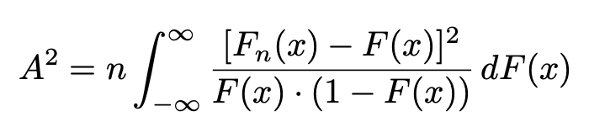
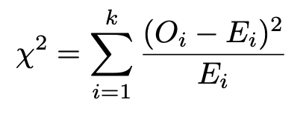
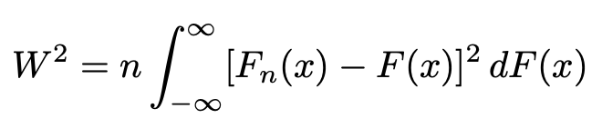
Test Statistics Definitions

Slide 6
Widespread Use in Actuarial Research
KS, AD, and Chi-square tests are widely used in modeling insurance losses, cyber risk, and catastrophe data.
Often combined with AIC/BIC.
How well GoF tests behave under the null (e.g., uniformity of p-values).
Whether the tests have sufficient power to detect slight misspecifications.
Practical consequences of GoF interpretation in actuarial decisions.
Study | Dataset Used | Tests Used
Miljkovic & Grün (2016) | Danish Insurance Fire Losses (n= 2492) | KS, AD, Chi-square
Eling & Loperfido (2017): | PRC Data breach dataset (n = 2266) | KS, AD
Ma & Ma (2013): | Insurance Data (n = 770) | KS, AD, not Chi-square
Notes:
P-values commonly reported & Heavy-tailed models frequently appear

Slide 7
The P-value Debate
The American Statistical Association (ASA, 2016) cautioned against the overuse and misinterpretation of p-values in scientific research.
In actuarial practice, where decisions carry financial weight, reliance on p < 0.05 can be especially risky.
Keep | Modify | Abandon
Murtaugh (2014), Lakens (2021) Correctly interpret and combined with other metrics | Benjamin et al. (2019) Lower threshold to p < 0.005 to reduce false positives | McShane et al. (2019) Argue for dropping rigid thresholds altogether.

Slide 8
Limitations of P-value
Over-simplification of Evidence:
P-values are often used mechanically to accept or reject hypotheses, ignoring deeper nuances.
Arbitrary Thresholds:
The widespread reliance on p < 0.05 excludes findings that may be practically meaningful but not “statistically significant.”
Encouragement of Questionable Practices:
The pressure to achieve significance encourages p-hacking and selective reporting, distorting the scientific literature.
Inconsistency Across Replications:
Similar findings (e.g., p = 0.004 vs p = 0.03) may be treated inconsistently, creating misleading replication judgments.
Neglect of Context:
P-values fail to account for study design, prior evidence, or real-world consequences—all essential in actuarial decision-making.

Slide 9
Simulation Framework
Evaluate the behavior of GoF tests under both correct and slightly incorrect model assumptions.
Burr Mixture: Fitted to Danish fire loss data (n=2492); best model per Miljkovic & Grün (2016).
Lognormal: Fitted to left truncated Secura Re automobile claims (n=371); selected as best by Blostein & Miljkovic (2019).
All null model parameters were taken directly from the respective papers to ensure realistic and empirically grounded setups.
Simulation Design:
Sample sizes: 10, 50, 100, 500, 1000, 2000, 2500
Simulations: 2000 per condition
Significance levels: α = 0.01, 0.05, 0.10
Both null and locally misspecified alternatives were tested.

Slide 10
Why These Models?
Burr Mixture:
Recognized for its flexibility, capable of mimicking shapes from normal, gamma, lognormal, and various Pearson families.
Underutilized in real-world data applications (Rodriguez, 1977; Tadikamalla, 1980).
Provides a realistic heavy-tailed structure crucial for actuarial risk modeling.
Lognormal:
Identified as the best fit for left-truncated loss data using AIC, BIC, VaR, and TVaR.
Left-truncation reflects common actuarial censoring scenarios (e.g., deductible thresholds).
Why These Two?
Together they represent two different real-world modeling challenges: heavy tails and truncation.
Their empirical selection as best models ensures that the simulations are grounded in actuarial practice, not hypothetical choices.

Slide 11
Why Local Model Misspecification?
Main idea is to challenge the tests with subtle, actuarially relevant shifts, not obvious model errors.
In practice, even the “best” model is just an approximation. Slight estimation errors are inevitable.
Introduce small deviations (3–8% parameter shifts) to simulate realistic modeling uncertainty, not obvious model failures.
Helps assess whether GoF tests can detect meaningful but subtle model misfit.
Avoids trivial rejections, ensuring that test power reflects practical usefulness, not just theoretical correctness.
Local misspecification is essential for understanding the sensitivity and robustness of GoF tests in actuarial science.
Notes:
Model misspecification occurs when the set of probability distributions considered by a statistician does not include the distribution that generated the observed data

Slide 12
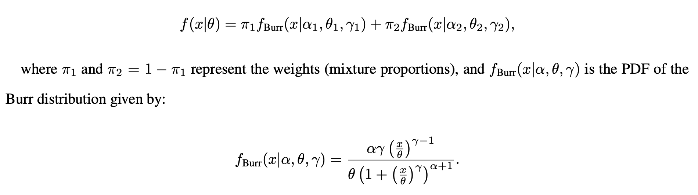
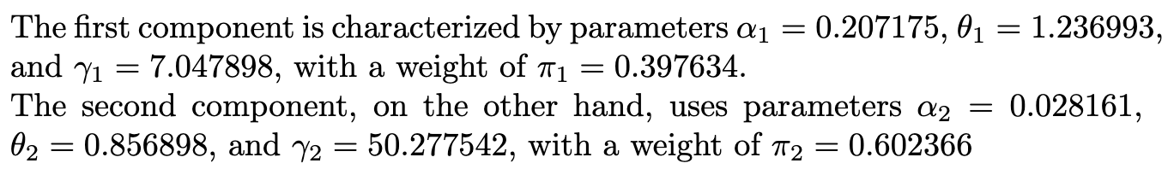
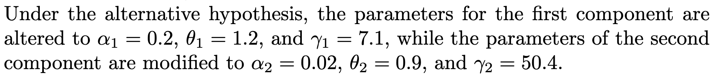
Burr Mixture Model
Notes:
Danish Insurance Fire Losses with n=2492. SMPracticals package and rbinom

Slide 13
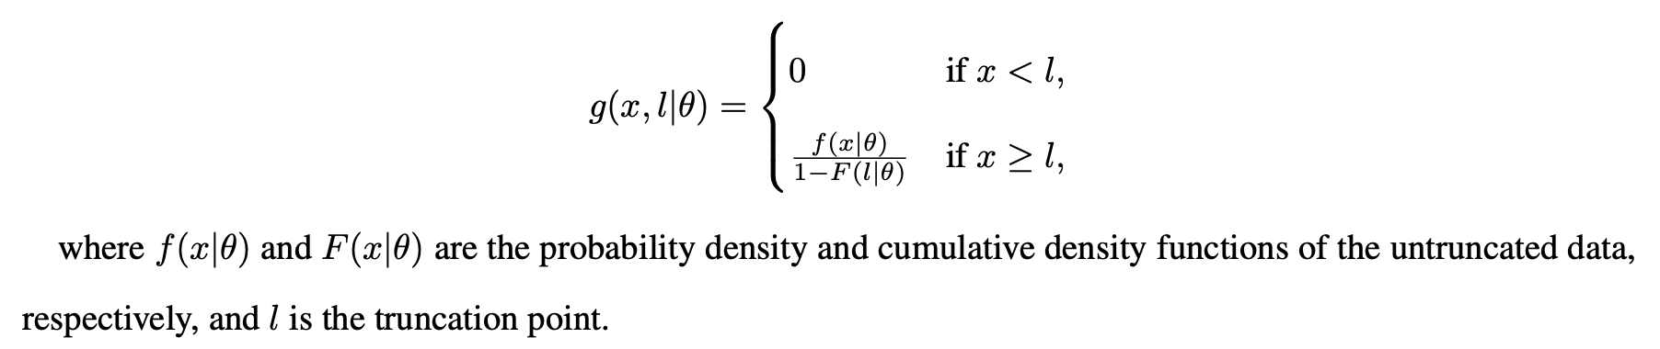
Lognormal Model
Losses are adjusted to 2002 Euro values and left-truncated at €1.2 million.
Model Definition:
Null model parameters: μ=14.3259, σ=0.5015
Misspecified alternative: μ=14, σ=1
Sampling Method:
Samples are generated via an acceptance-rejection method, drawing from the untruncated lognormal and retaining values ≥1.2
This ensures realistic truncated samples under both the null and alternative.

Slide 14
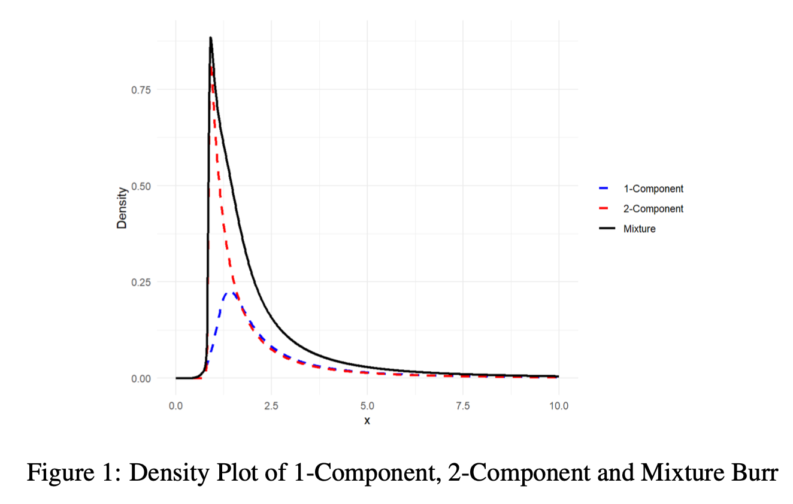
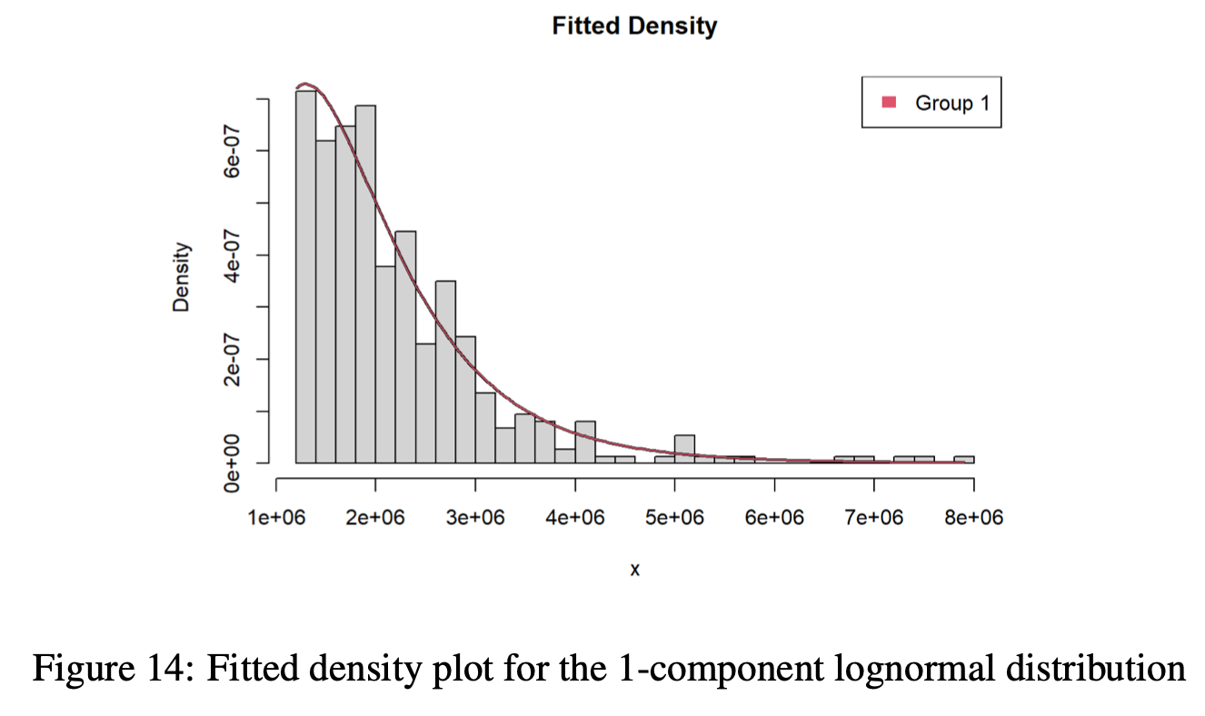
PDF Plots of Models

Slide 15
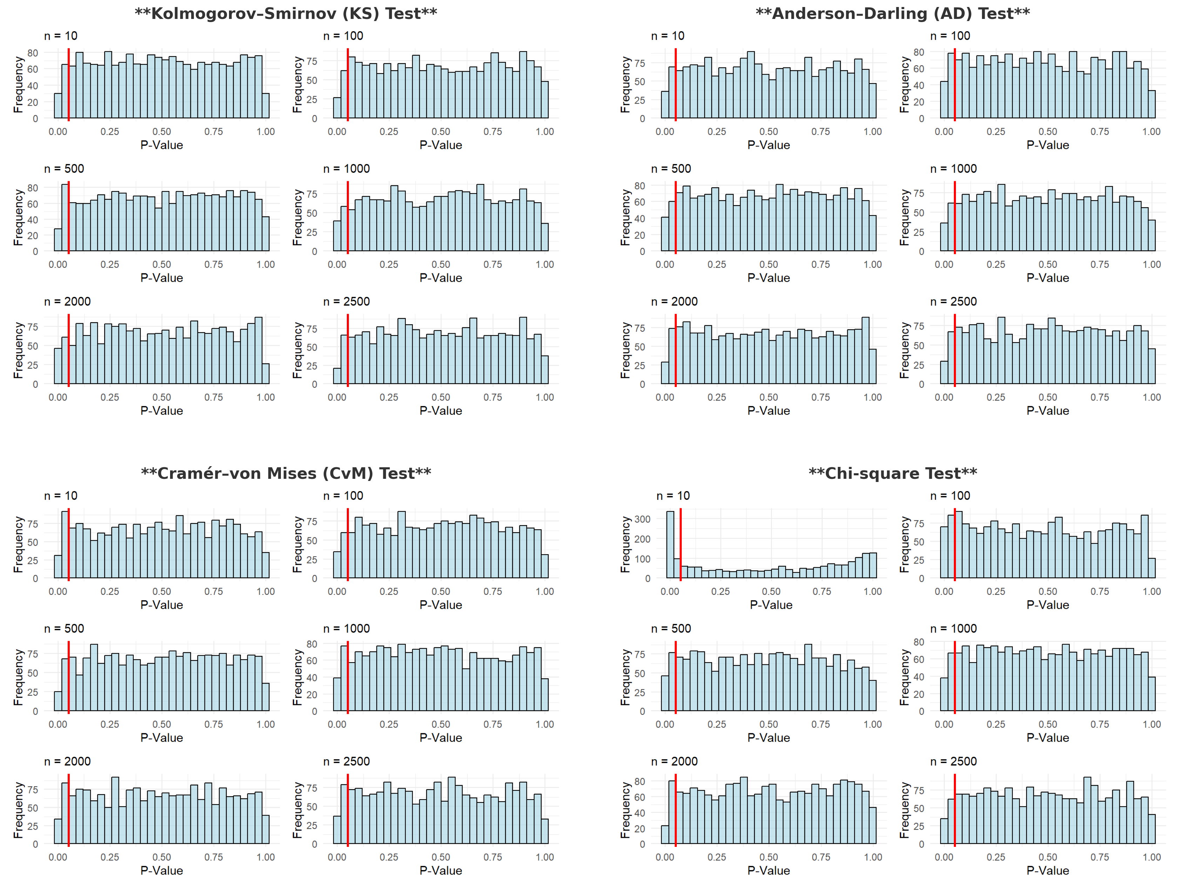
P-value distributions – Burr Mixture (Null)

Slide 16
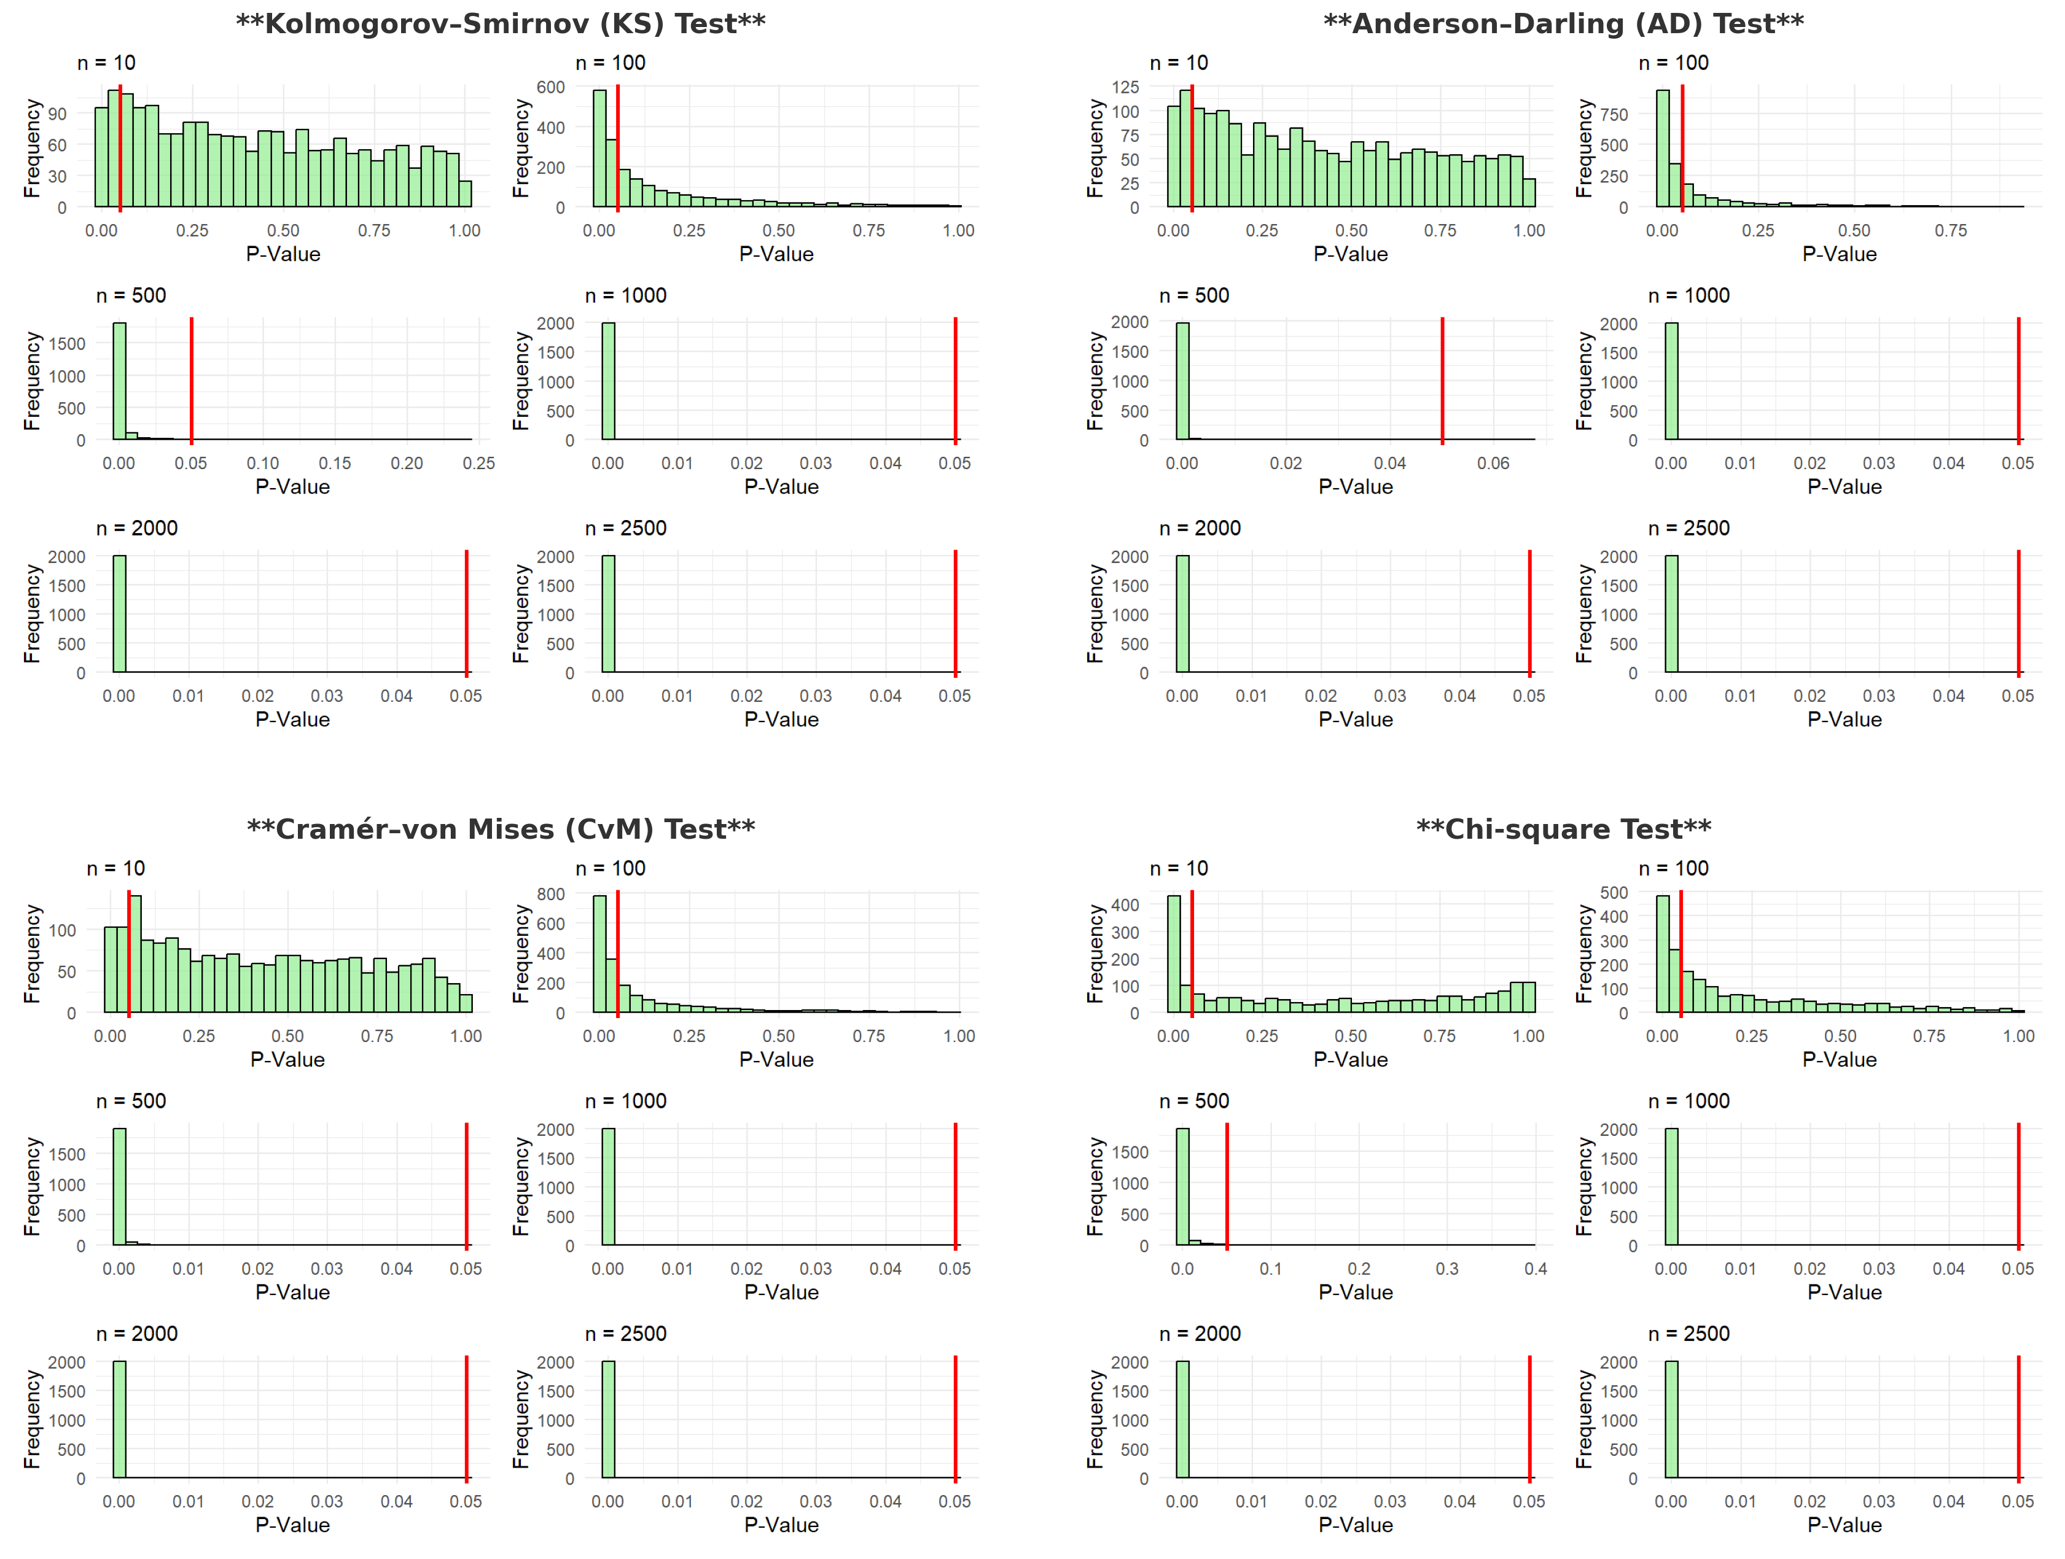
P-value distributions – Burr Mixture (Alternative)

Slide 17
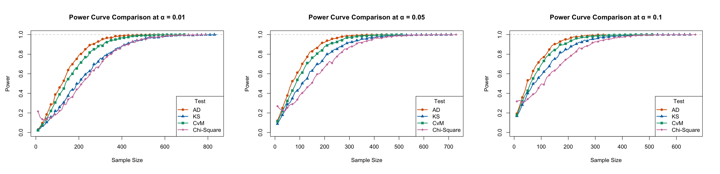
Power Curve Comparison Across Alpha Levels

Slide 18
Empirical Type I Error and Power at α = 0.05
Sample Size | KS (Type I / Power) | AD (Type I / Power) | CvM (Type I / Power) | Chi-sq (Type I / Power)
10 | 0.05 / 0.08 | 0.05 / 0.13 | 0.06 / 0.11 | 0.23 / 0.26
100 | 0.05 /0.46 | 0.05 / 0.67 | 0.05 / 0.57 | 0.09 / 0.38
500 | 0.05 / 0.99 | 0.04 / 1.00 | 0.05 / 1.00 | 0.06 / 0.99
2500 | 0.05 / 1.00 | 0.05 / 1.00 | 0.05 / 1.00 | 0.05 / 1.00
KS (n=710)
AD (n=450)
CvM (n=550)
Chi-square (n=730)

Slide 19
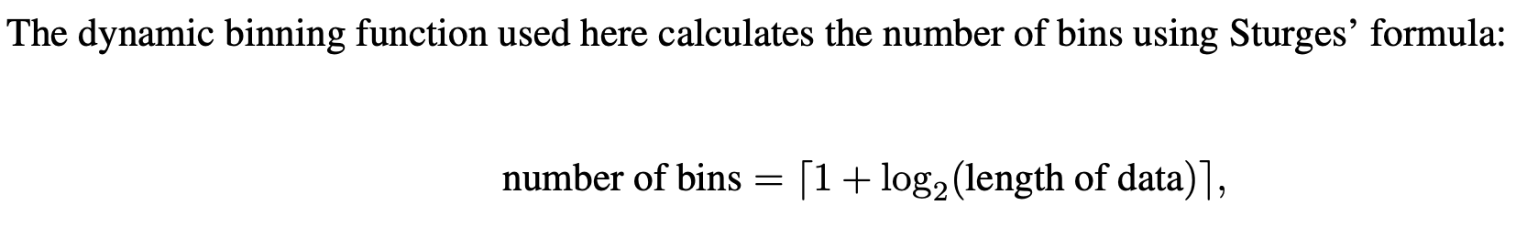
Key Observations
All tests demonstrate improved power with increasing sample size.
Anderson-Darling (AD) consistently leads in power across most sample sizes.
Cramér-von Mises (CvM) performs closely behind AD and surpasses KS at moderate sizes.
Kolmogorov-Smirnov (KS) improves steadily but lags behind AD and CvM, especially at smaller sizes.
Chi-square test shows the weakest power, particularly at small and moderate sizes.
Higher α levels (e.g., 0.10) boost power earlier across all tests.
At stricter α (e.g., 0.01), the tests require larger sample sizes to reach near-perfect power.
The Burr Mixture model, with its complex heavy tails and multimodality, favors AD and CvM for detecting slight misspecifications.
Chi-square's poor performance in this context highlights limitations when bins do not reflect underlying distribution shape well.

Slide 20
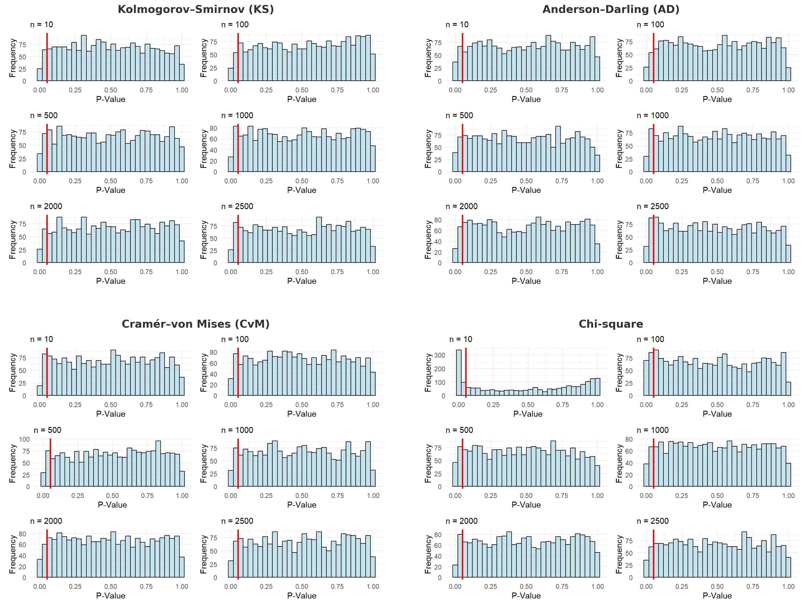
P-value distributions – Lognormal (Null)

Slide 21
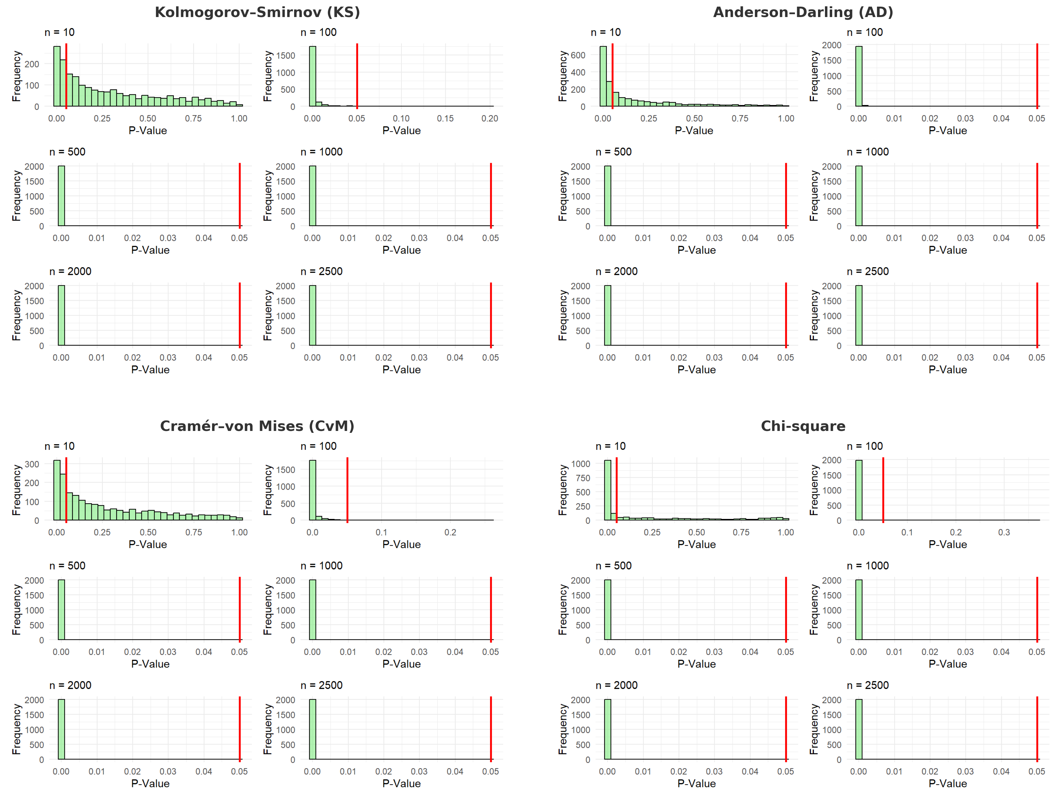
P-value distributions – Lognormal (Alternative)

Slide 22
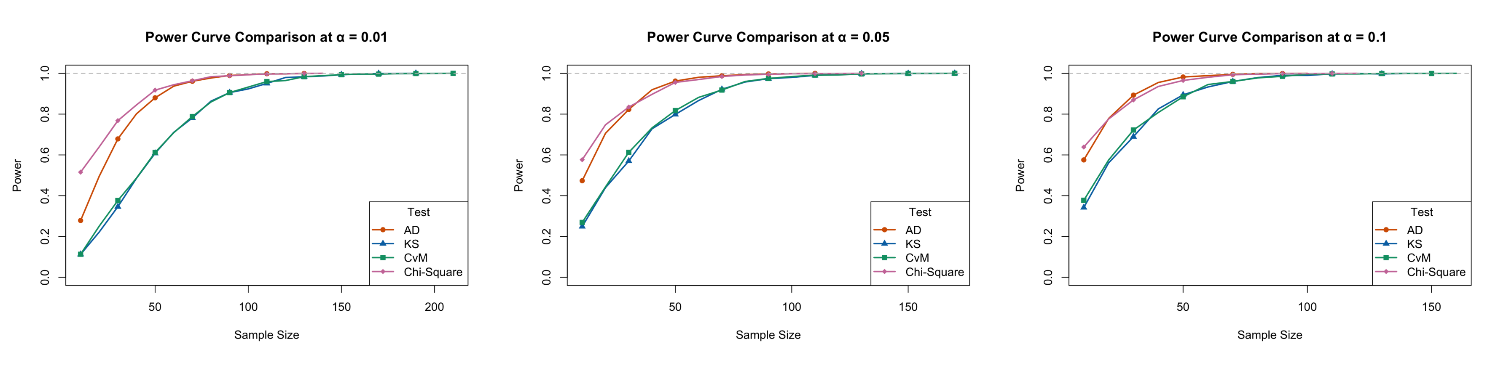
Power Curve Comparison Across Alpha Levels

Slide 23
Empirical Type I Error and Power at α = 0.05
Sample Size | KS (Type I / Power) | AD (Type I / Power) | CvM (Type I / Power) | Chi-sq (Type I / Power)
10 | 0.06 / 0.24 | 0.05 / 0.47 | 0.04 / 0.27 | 0.22 / 0.57
100 | 0.05 /0.99 | 0.05 / 1.00 | 0.04 / 0.99 | 0.09 / 1.00
500 | 0.05 / 1.00 | 0.06 / 1.00 | 0.06 / 1.00 | 0.06 / 1.00
2500 | 0.04 / 1.00 | 0.05 / 1.00 | 0.05 / 1.00 | 0.05 / 1.00
KS (n=170)
AD (n=110)
CvM (n=170)
Chi-square (n=130)

Slide 24
Key Observations
All four tests show increasing power with sample size, as expected.
At small sample sizes (n ≤ 50), differences across tests are more pronounced.
Chi-square test consistently shows higher power at smaller sample sizes across all α levels.
AD tests follow closely and catch up quickly as sample size increases.
KS and CvM lags slightly behind in early samples but performs comparably as n grows.
Higher α (e.g., 0.10) results in faster convergence to high power, especially for all tests.
At α = 0.01, differences are more visible, useful for conservative testing strategies.
For the slightly misspecified lognormal alternative, Chi-square and AD appear most sensitive.
Highlights the importance of considering both sample size and test selection when designing GoF assessments in actuarial settings.

Slide 25
Power Trends across both models
Burr Mixture
More challenging to detect misspecification.
Gradual rise in power; larger samples needed for reliable rejection under alternatives.
AD and CvM outperformed others across sample sizes and alpha levels.
Left-Truncated Lognormal
Easier to detect deviation from the null.
All tests reached near-perfect power quickly (by n ≈ 100–200).
Steep power increase even under α = 0.01.
Tests maintained Type I error rates close to nominal levels across models.
Lognormal case: Tests highly sensitive, strong rejection of the alternative.
Burr case: Tests needed more observations to distinguish subtle differences.
Test effectiveness is model-dependent.
While AD and CvM generally excel, sample size and model structure shape their diagnostic power.
Practitioners should not rely on a single test or α threshold without considering model complexity.

Slide 26
Conclusion & Reflection
This study shows that p-values alone are not sufficient for assessing model adequacy. Their reliability depends on:
The GoF test used
Model structure (e.g., heavy tails or truncation)
Sample size and significance level
Degree of misspecification
Implications for Practice
Model validation in actuarial science should not rely on a single test or p-value.
Use test power, data structure, and visual tools to complement GoF tests.
Supports calls in the literature for a more nuanced and critical use of p-values.
Looking Ahead
Evaluate resampling-based or Bayesian methods
Apply these diagnostics in real-world actuarial applications
Study effects of more complex forms of model misspecification
“Model fit is not a binary outcome, rather a judgment call informed by evidence, context, and consequence.”

Slide 27
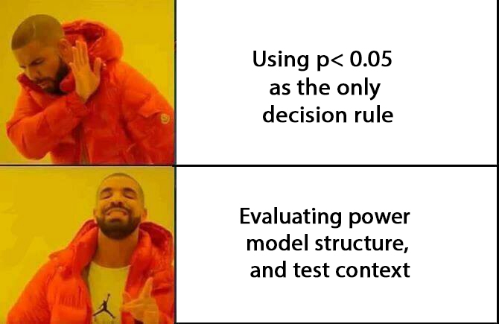

Thank you!

